Slide 1
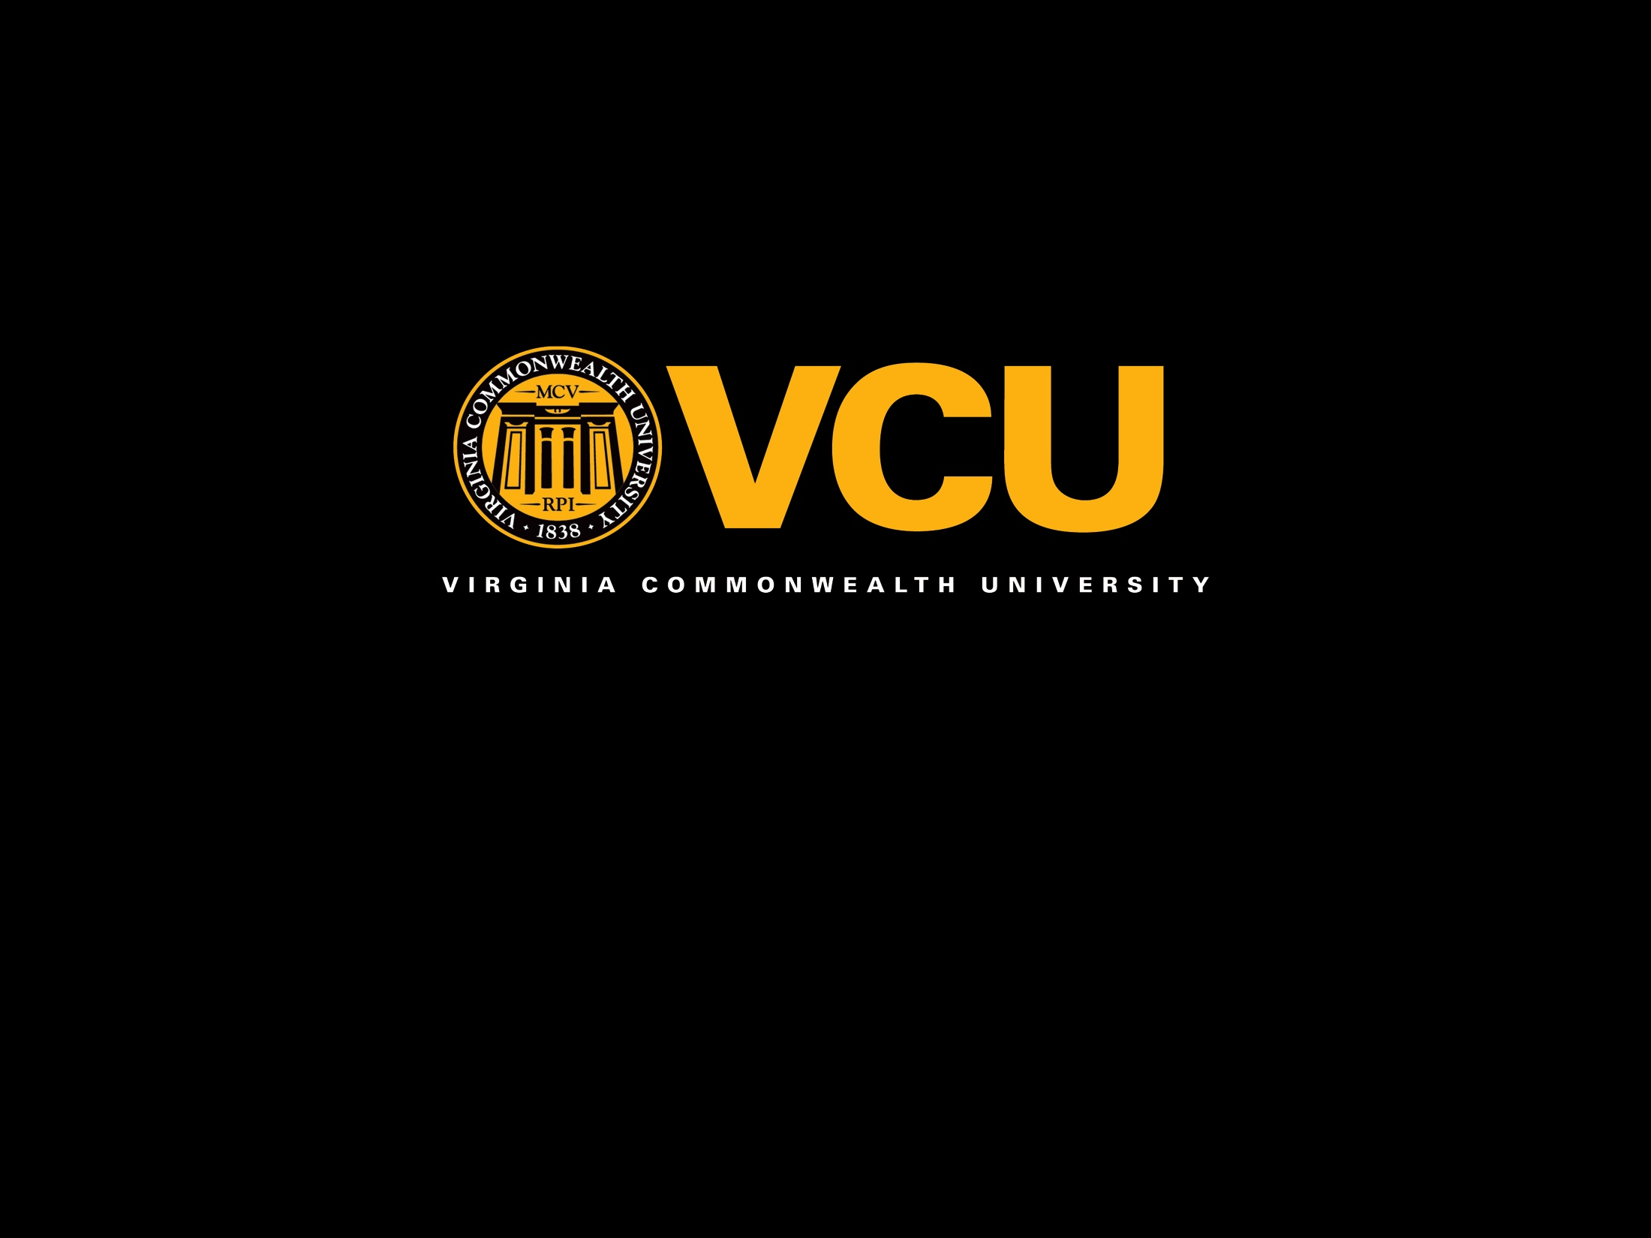

Slide 2

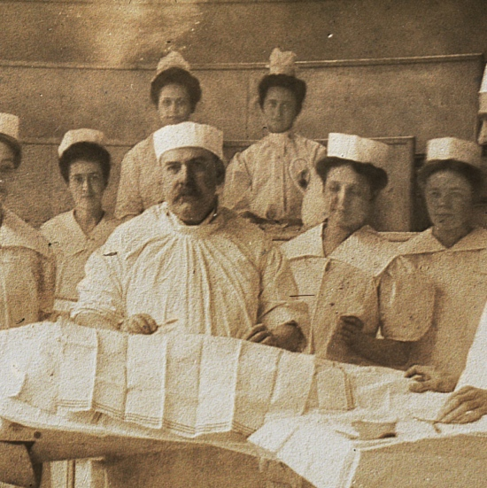
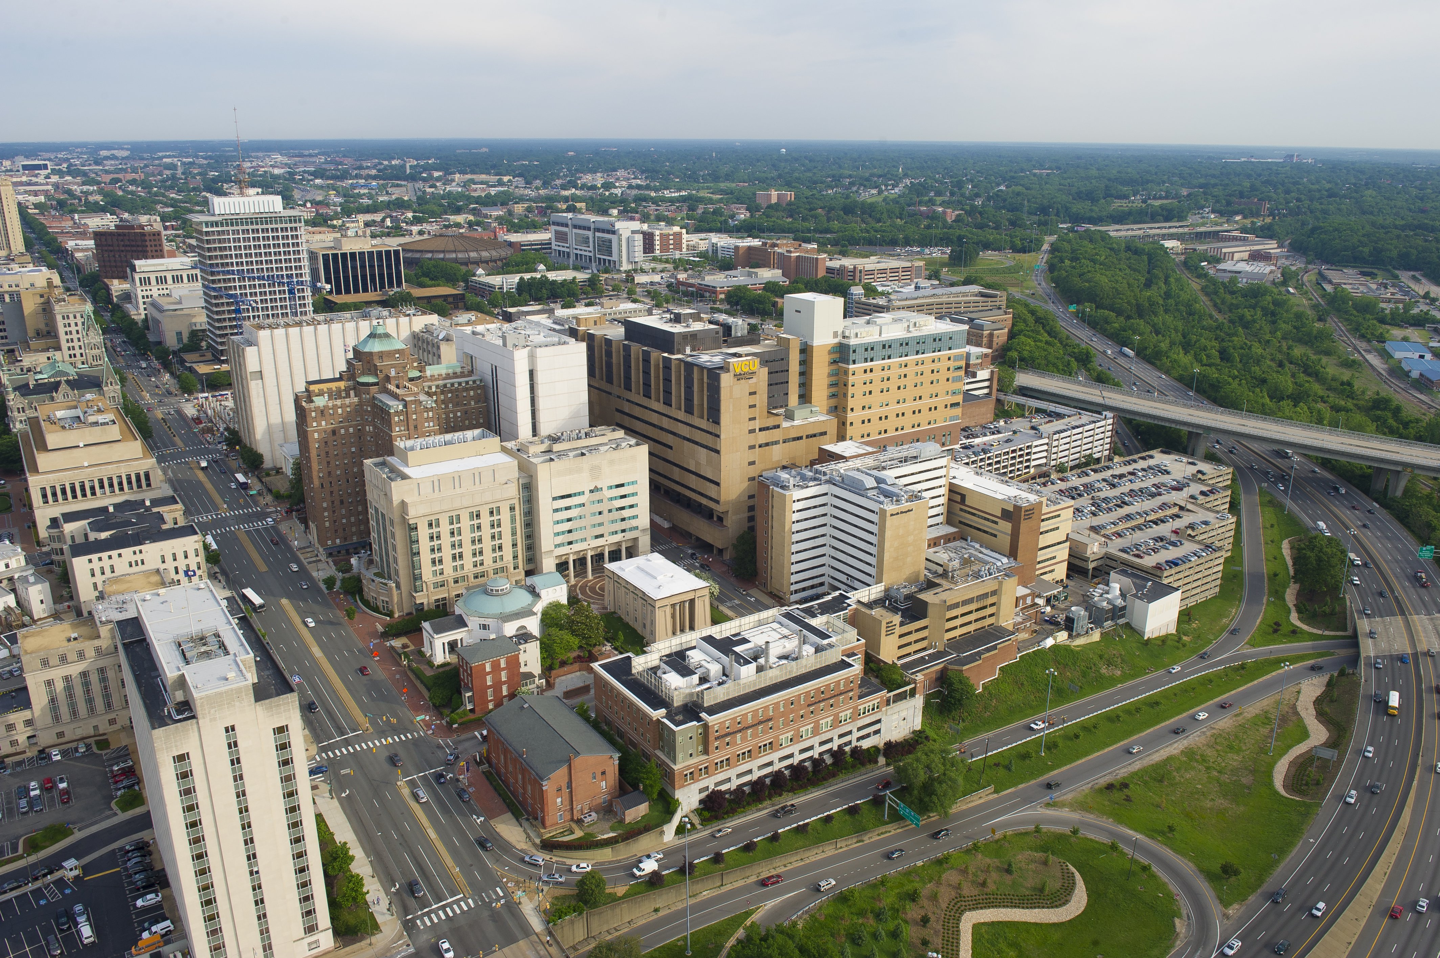
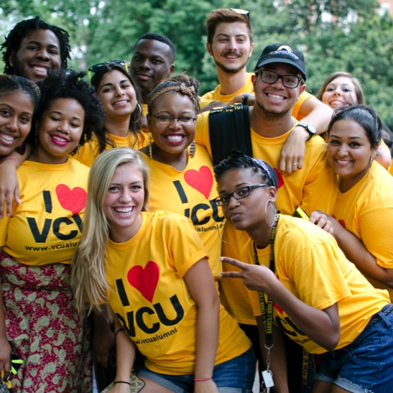
We are a premier urban, public research university focused on academic success.
Established in
1838
Located in
Richmond, Virginia
More than
171,000 alumni worldwide

Slide 3
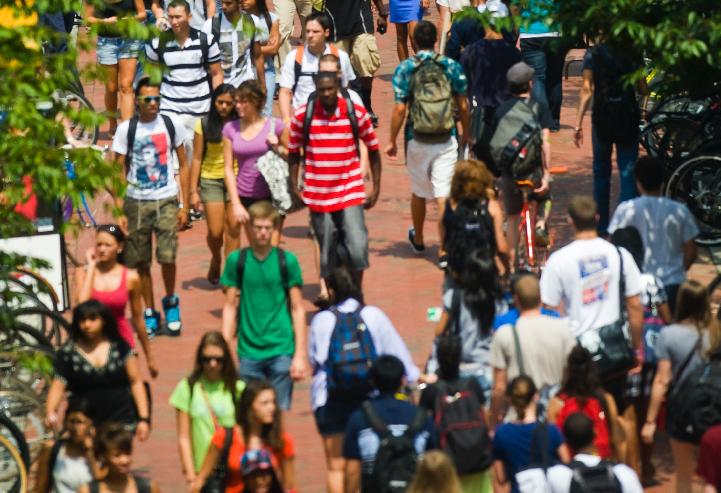
» 31,288 students
» 100 countries represented in student population
» 11, 388 employees
» 2,170 full-time instructional faculty
The VCU
population

Slide 4
Academic programs
13
schools and
one college
222
64 baccalaureate degree programs
74 master’s degree programs
40 doctoral degree programs
3 first-professional degree programs
41 post-baccalaureate and
post-master’s certificate programs
degree and
certificate programs

Slide 5
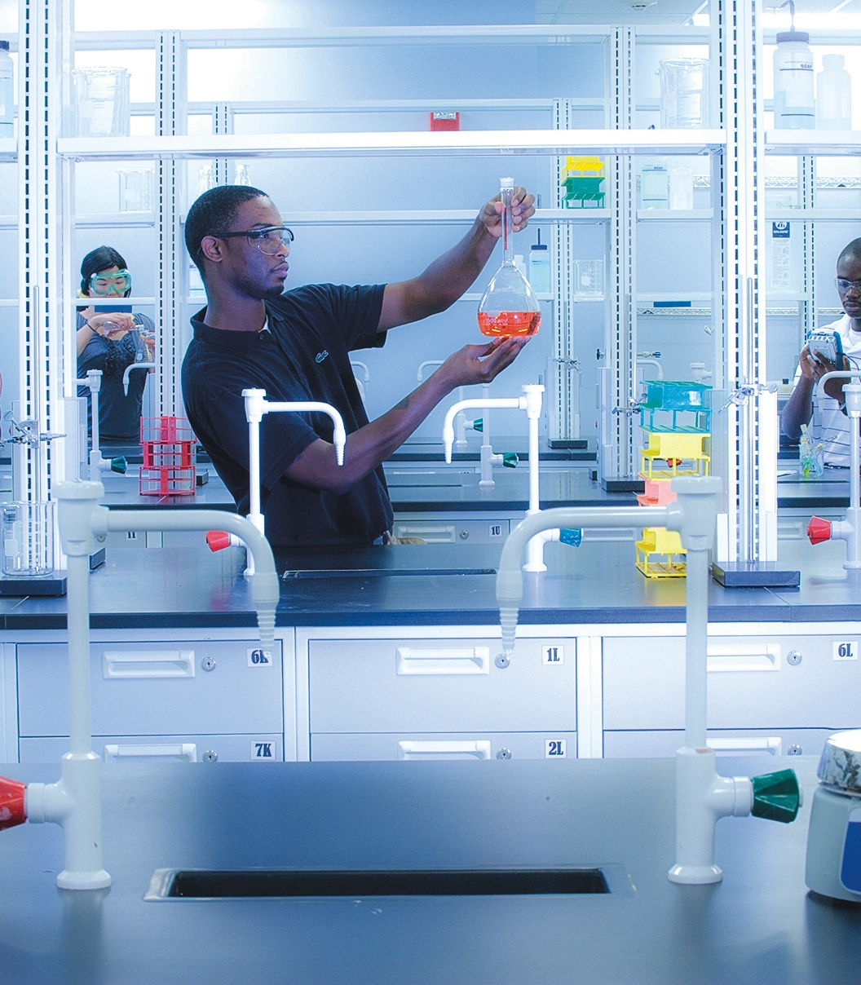
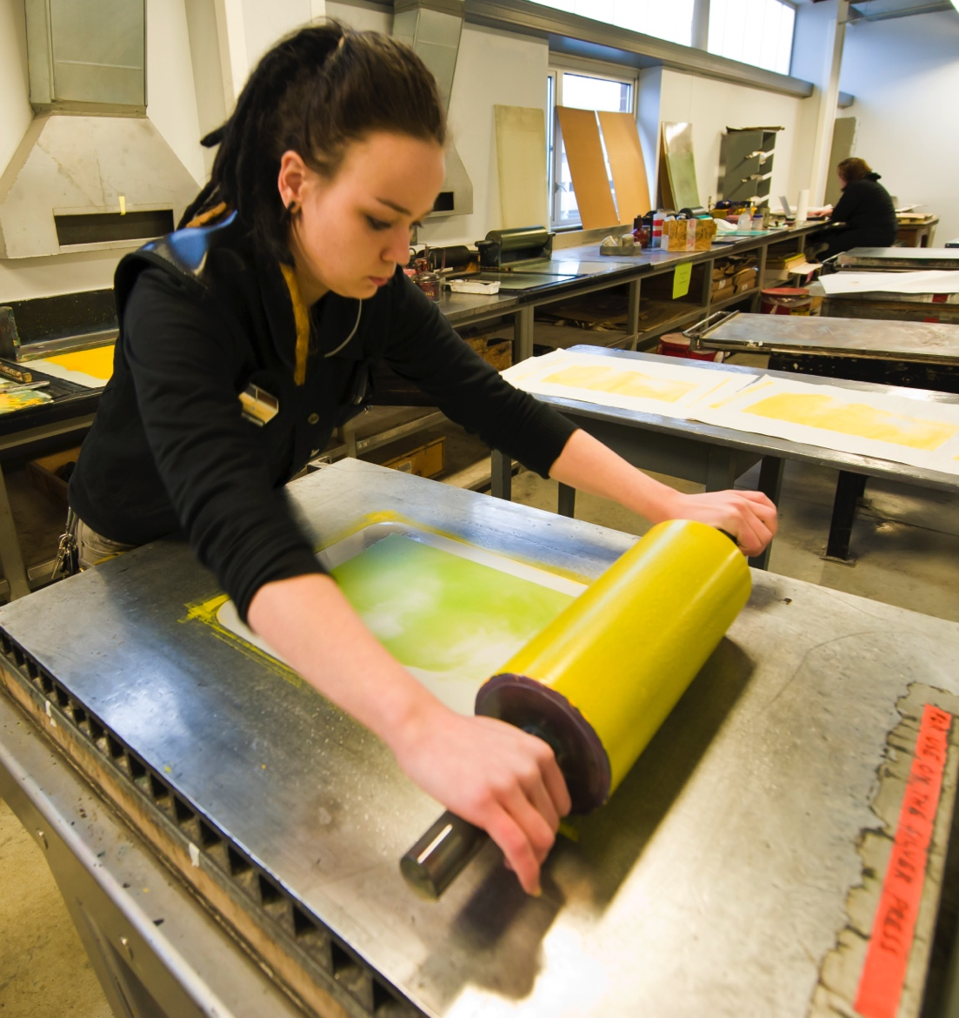
Innovation,
research and
creative expression
» $262.3 million in sponsored research
» 138 patents filed in FY 2014
» Top 200 research university worldwide, according to Academic Rankings of Worldwide Universities in Shanghai
» No. 1 hospital in Richmond region, top honors for safety and quality of care

Slide 6

Campus life and athletics
17
NCAA Division I men’s and women’s athletic teams
More than 1 million hours
of community service
More than 500
student organizations

Slide 7
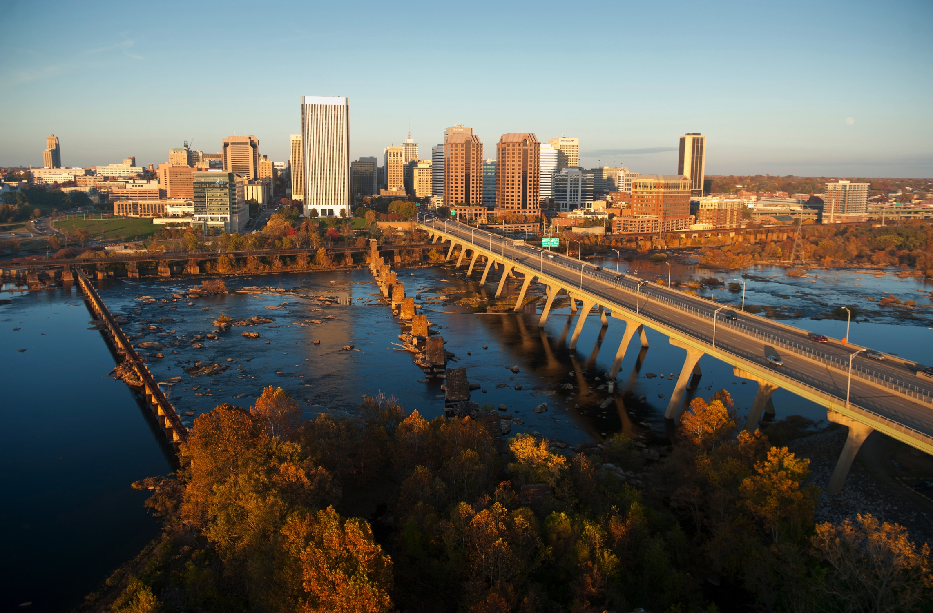
Campus life and athletics
16
NCAA Division I men’s and women’s athletic teams
More than 1 million hours
of community service
More than 500
student organizations
» Virginia’s capital city
» Home to six Fortune 500 companies
» Growing innovation ecosystem
» Thriving arts community
About Richmond

